Slide 1
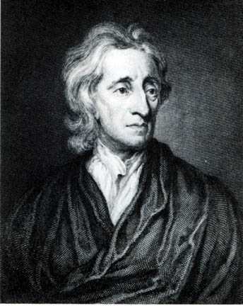
Unit 1 Study Guide Use your notes or Mrs. L.’s website www.mrslepkowskivbms.weebly.com to fill in the answers
What philosopher told us about State of Nature and Natural Rights?
-----------------------------------
What does State of Nature mean? _________________________________________________________________________________________________________________________________
What a cutie! LOL!

Slide 2
What are a human’s natural rights?
___________________________________ Example:_____________________________________________________________________________________________________________________________________
___________________________________
Example:_____________________________________________________________________________________________________________________________________
___________________________________
Example:_____________________________________________________________________________________________________________________________________

Slide 3
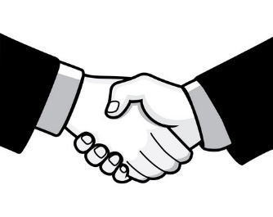
What is government? The way a society decides to structure authority in order to protect our __________________. John Locke called government a S_________________C______________. Or an agreement between the governing and the governed.
Why do we need government? (You tell me!)
Government provides public goods and s_____________, that we wouldn’t be able to provide ourselves.
Some examples would be:
Schools
P_________
H_____________
Military (Defense)
Mrs. L. can’t defend our country by herself!

Slide 4
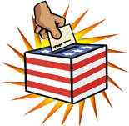
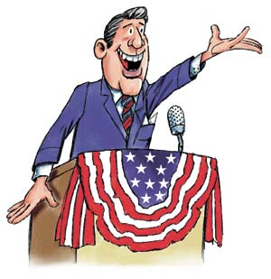
Our government is a Democracy. This means people r_____.
People rule by v___________ and electing people to represent them in government (we can’t all go to D.C. We have jobs & family responsibilities!)
This is called R____________________G______________________
I represent you!

Slide 5
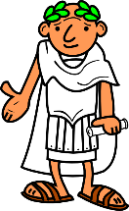
Democracy (people rule) began in ancient times in a place called A_________, Greece. Only the men could vote, though.
Then the Magna C_______________ came along in _______. (year)
Magna Carta = Limited Government
Limited Government means ____________________________________.
Wealthy nobles called N_____________, were the only people this applied to.
In the Magna Carta we see the following law (court) processes we still use today:
Trial by j_____ of one’s peers
No loss of p_____________ (stuff you own) unless found guilty of a crime.
People had the right to see e______________ against them
Right to bring w_________________ to help you
ONLY APPLIED TO NOBILITY!

Slide 6
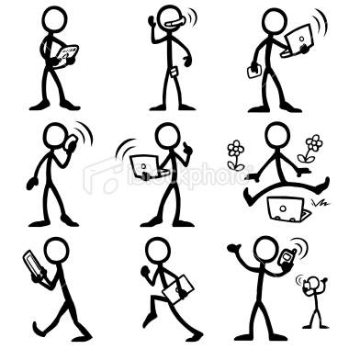
A couple hundred years later, in 16__, The English Bill of Rights was written. English Bill of R_______ Kept the trial, witness, evidence rights from the Magna Carta and Li__________ G___________ but now… Equal Rights By Law given TO ALL CITIZENS (no longer just for nobility!)
English Bill of Rights
Government has limits! All citizens have equal rights!
Woohoo! We are equal!

Slide 7
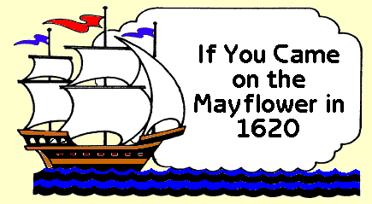
Mayflower Compact is important because…
Their ship/colony was so far away from England the people decided to make their own laws without the K_____’s permission.
This led to:
Popular Sovereignty
Popular means- liked or chosen by the people
Sovereignty means- power/authority
People + power/authority = P______________ S________________
Self –rule What does that mean? ____________________________
_________________________________________________________
Consent of the Governed
Consent means- p___________________
Governed means- body of p______________ who are citizens of a government
Consent (permission) from people to be governed.
When you consent to be governed you agree (consent) to live by the laws and government will provide you with g________ & s_______________, that you can’t get for yourself.
Riding to
America!

Slide 8
Fundamental Principles of Democratic Governments
Protection of fundamental f____________
C___________ of the governed
Limited g________________
R______ of law
R_____________________ government
Majority rule with the protection of minority rights

Slide 9
Match the Democratic Principle (listed on previous page) with the example it goes with…….
Mrs. L. is sad that her candidate, Mr. Vitale, didn’t win the majority of votes in the election. The majority (most) of the votes went to Big Nasty. No one can abuse the losing candidate (Mr. V.) or Mrs. L. because they were the minority of voters (least amount) and lost.
_________________________________________
Sour Patch Kid is sitting on his couch eating Doritos. The police and his neighbors walk into his house and start going through his property and take several items. They can’t do this because he has protection of his
_________________________________________
Karson is the King of Lepkowski Land and tries to take Shamar’s new Lexus, but he can’t do that anymore because of _________________________________________
President Obama is speeding in his Porsche and gets pulled over. The officer gives him a ticket. This is an example of _________________________________________
Mrs. Toth decides to run for Congress. She wants people to vote for her so she can to represent them at meetings in our capital- Washington, D.C.
_______________________________________________
Big Nasty, Supreme Shamar, King Karson and Sour Patch Kid all see Mrs. L. at the oceanfront trying to stop a military ship (from another country) from attacking our shores. She is not making a difference. Her water gun can’t shoot very far. They realize citizens need to give up some freedom and live by the law to get protection from the government (military/defense).
________________________________________________________________

