Slide 1
Review of Why Do we Need Government?
The government satisfies some of the economic and social needs
Public goods and services provided by the government
Allows benefits to be provided to large groups at the same time
May not happen if individuals had to provide them
Examples: interstate highways, postal service, national defense

Slide 2
Fundamental Principles of Democratic Governments
Protection of fundamental freedoms
Consent of the governed
Limited government
Rule of law
Representative government
Majority rule with the protection of minority rights

Slide 3
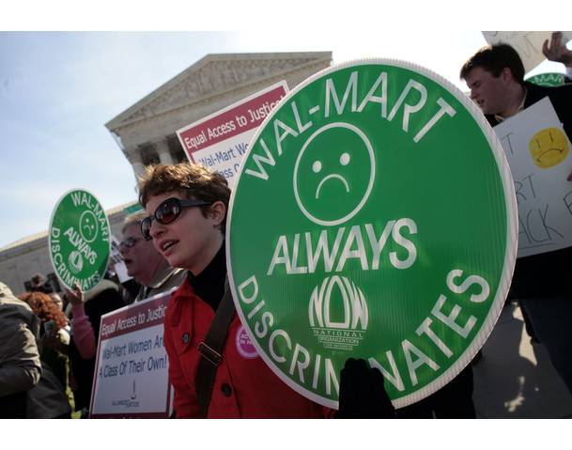
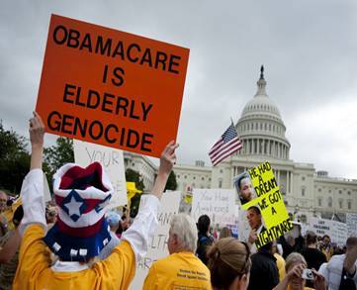
Look at these pictures and think about what democratic principle is being exhibited?

Slide 4
Protection of fundamental freedoms
In a democracy certain freedoms will be protected
What document(s) protects American's rights?
Example from society:
Example from school:

Slide 5
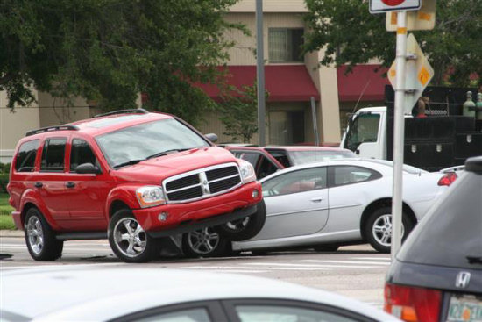
Look at these pictures and think about what democratic principle is being exhibited?

Slide 6
Consent to be governed
Who is the philosopher that we studied this week that had ideas on this topic?
As a citizen you agree to have a government to create laws that protect your natural rights.
Example from society:
Example for school:

Slide 7
Look at these pictures and think about what democratic principle is being exhibited?

Slide 8
Limited government
Government is not all powerful, there are limits on what they may do
The people give the government its power
Example from society:
Example from school:

Slide 9
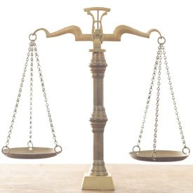
Look at these pictures and think about what democratic principle is being exhibited?

Slide 10
Rule of law
The government an those who govern are bound by the law
Example from society:
Example from school:

Slide 11
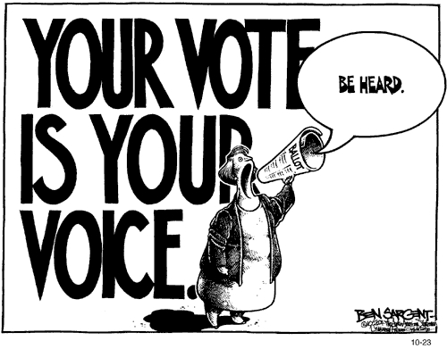
Look at these pictures and think about what democratic principle is being exhibited?

Slide 12
Representative government
People elect public officeholders to make laws and conduct government on their behalf
Example from society:
Example from school:

Slide 13
Look at these pictures and think about what democratic principle is being exhibited?

Slide 14
Majority rule with protection of minority rights
In an election the side with the most votes wins (majority)…….so what about the minority?
The majority cannot violate the inalienable rights of the minority
The minority has the ability to change the majority every time there is an election
Example in society:
Example in school:

