Slide 1
Good Citizenship
Weak Citizenship
During the last Presidential election, Marcus not only cast a ballot in his home state of Vermont, but also in each of his neighboring states.
GOOD CITIZENSHIP
WEAK
CITIZENSHIP

Slide 2
Good Citizenship
Weak Citizenship
When visiting her sister-in-law’s house over the summer, Rachel called everyone stupid for watching the Fox News Channel.
GOOD CITIZENSHIP
WEAK
CITIZENSHIP

Slide 3
Good Citizenship
Weak Citizenship
After running a stop sign, Frank – an off-duty police officer – shows his badge to the officer who pulled him over.
GOOD CITIZENSHIP
WEAK
CITIZENSHIP

Slide 4
Good Citizenship
Weak Citizenship
Even though he had always voted Republican, William thought that the Democratic candidate was more experienced and better for the office.
GOOD CITIZENSHIP
WEAK
CITIZENSHIP

Slide 5
Good Citizenship
Weak Citizenship
Even though he was late for his doctor’s appointment, Dan was happy that he stopped to help a young woman change her flat tire.
GOOD CITIZENSHIP
WEAK
CITIZENSHIP

Slide 6
Good Citizenship
Weak Citizenship
Sarah “unfriended” Carly on Facebook after she refused to come over to help her with her math homework for the tenth night in a row.
GOOD CITIZENSHIP
WEAK
CITIZENSHIP

Slide 7
Good Citizenship
Weak Citizenship
Andrew pauses to remember the men and woman of the U.S. armed forces on Veteran’s Day.
GOOD CITIZENSHIP
WEAK
CITIZENSHIP

Slide 8
Good Citizenship
Weak Citizenship
After Hurricane Isaac toppled trees in his neighborhood, Mike grabbed his chainsaw, jumped in his truck, and went from house to house helping to clear the yards.
GOOD CITIZENSHIP
WEAK
CITIZENSHIP

Slide 9
Good Citizenship
Weak Citizenship
Natalie shouts at the City Council that they are not being fair when they tell her that she is still 2,000 signatures short on her petition.
GOOD CITIZENSHIP
WEAK
CITIZENSHIP

Slide 10
Good Citizenship
Weak Citizenship
Even though no one saw her do it, Stephanie leaves a note on the windshield of the car admitting that she was the one who caused the dent in the car’s rear bumper.
GOOD CITIZENSHIP
WEAK
CITIZENSHIP

Slide 11
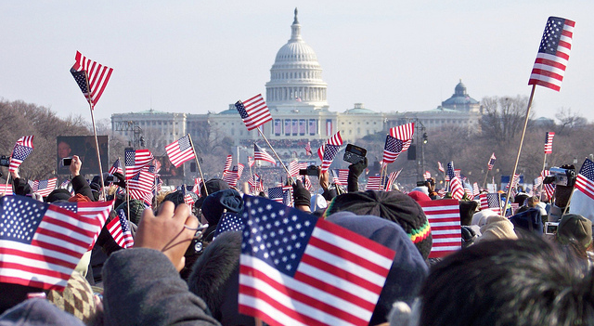
Unit 1
We The People: A Government of Citizens
Section 8.1.10 – Identify personal traits of goods citizens.
Section 8.1.11 – Identify ways citizens participate in community service.
Section 8.1.12 – Identify the skills involved in effective participation in civic life.

Slide 12
Honesty / Trustworthiness
Doing the right thing, even when no one is looking at you.
When others feel comfortable trusting you.
Honest people quickly develop trustworthiness with other people.

Slide 13
Patriotism
Is a sense of duty, love, and respect for one’s country.
True patriots serve their country as civil servants, volunteers, or service men and women.
Patriotism can determine things like security clearance for high-level government jobs – secret service and Navy SEALS.

Slide 14
Respect
Is one of the most important things good citizens can show to one another.
Influences all of the other traits of good citizenship.
Can help form other people’s opinions of you, as well as good first impressions.

Slide 15
Responsibility / Accountability
Owning up to your actions and accepting consequences, good or bad.
Others can hold people accountable. For example: if they break the rules, or they do something incorrectly.

Slide 16
Obedience
Conforming to the rules and submitting to authority or doing what you are told.
Good citizens exercise obedience by obeying the laws of the land where they live.

Slide 17
Courtesy
Showing politeness and being considerate of others.
Good citizens are courteous to those around them.
Citizens can show courtesy by being polite to others.

Slide 18
Self-Reliance
When one takes responsibility for their own welfare.
Self-reliant people don’t need to depend on others for their day-to-day living.
Self-reliant people prepare themselves during easy times for hard times down the road.

Slide 19
Turn and Talk
How can YOU participate in community service?

Slide 20
Ways for citizens to participate in community service
Volunteering for organizations
Volunteering for public service organizations.
tutoring
Expressing concern about public issues
Good citizens participate in making society better by performing community service.

Slide 21
Ways for citizens to participate in community service
Good citizens participate in making society better by performing community service.
Community service is not just limited to voluntary acts – sometimes it can be given as a punishment for a crime.

Slide 22
Identify skills involved in effective participation in civic life
Formulating questions
Analyzing information
Expressing a position
Devising and implementing a plan

Slide 23
Turn and Talk
Why are these citizenship skills important to YOU?
When could YOU use these citizenship skills and how?

Slide 24
Time to think…
We have talked about duties, responsibilities, and personal character traits of citizens. Can you think of any citizen who does not need to follow the duties and responsibilities of citizenship?
Why do we need to follow the duties and responsibilities?

Slide 25
Fundamental principle of democratic government
NO ONE
IS ABOVE
THE LAW!

Consent of the Governed
Rule of Law – Citizens are bound to
follow ALL laws.

