Slide 1
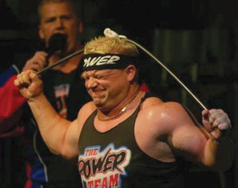
I’ve got the POWER!!!

Slide 2
What is the POWER Paragraph?

Slide 3
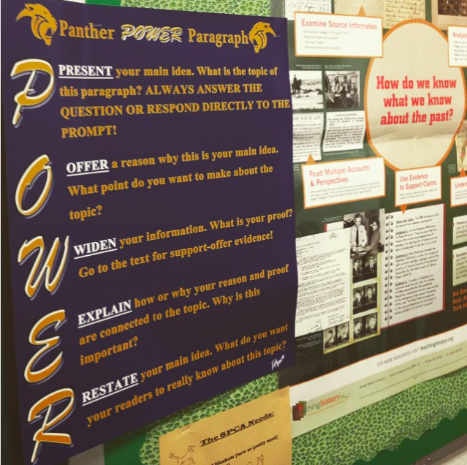
School-wide initiative

Slide 4
How do we know that the POWER Paragraph is effective?

Slide 5
Percentage of students who wrote “good” essays on the Grade 8 SOL Writing Test: 2014 2015 % increase Overall: 74.5% 88.0% +13.5% Advanced classes: 85.7% 98.4% +13.7% Core classes: 57.0% 72.7% +15.7% IEP students: 37.5% 50.0% +12.5%

Slide 6
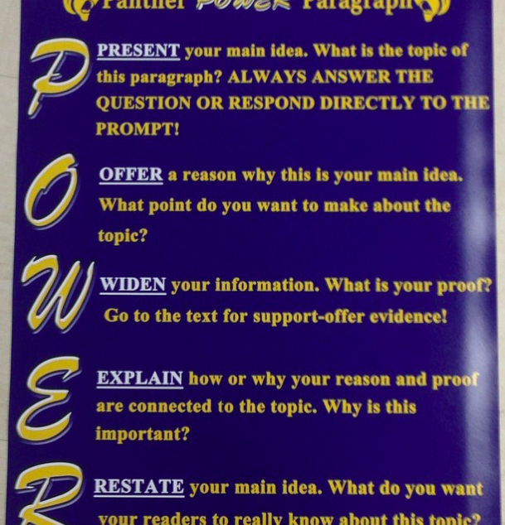

Slide 7
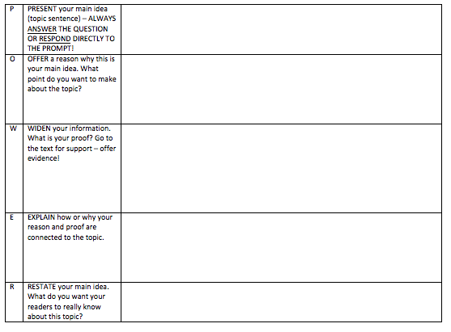

Slide 8
Let’s try it!
Your prompt: Describe one awesome thing about teaching.
P
O
W
E
R

Slide 9
Let’s try it!
Your prompt: Describe one awesome thing about teaching.
P Present your idea
O Offer a reason to support
W Give a specific example
E Explain how the W supports the O
R Re-state your idea

Slide 10
POWER essay:
0. Read and re-state the prompt.
1. Answer the prompt.
2. Brainstorm around 10 supporting details.
3. Choose your 3 strongest supporting details.
4. Create 3 POWER paragraph charts (one for each reason).
5. Write an intro paragraph (answer prompt, preview 3 paragraphs, transition).
6. Write a conclusion paragraph (transition, re-state answer, recap 3 main points, state answer one more time).
7. Write 3 body paragraphs using your POWER charts (add transitions).
8. Re-read/proofread (“act like you’re not you”)

Slide 11
Diagnostic essay, September 2014.
Everyone has a talent or skill. Identify a talent or skill you have, and explain how you develop and use it. Use specific details and examples in your response.
The skill that I have is when I have a problum with my schoolwork or group project I try my best to solve it so me and everyone around me turnes out ok.
When I was in 4th grade, my gruop and I were getting behind on a a project. i decited to show the work that I have done. And it worked. We started to geta move on. Or project turned out ok. Another problum that I had was in 6th grade. I got two E's on my last progress reaport. I tryed best as I could to step up on my mistake and to focuse more on school. I eventually got my report card back and said that I turned my first E in to a B- and my second to a C. IT was very excitng for me. So that was two exsamples of what my skill is and how it comes in handy.

Slide 12
Survey Answers, January 2015.
Q: Explain your level of confidence in regards to POWER paragraphs:
A: its the same as a normal paraghraph except easier
Q: Explain your level of confidence in regards to essay writing:
A: essay have to be big and are sort of immtimiadating. the steps helps me do it just fine

Slide 13
SOL practice essay, March 2015.
Some people think that schools should offer only nutritious drinks such as white milk, water, and natural fruit juice. Do you agree or disagree with this policy?
I think we should be able to drink other beverages than white milk, water, and natural fruit juice. Kids should be able to get energy drinks to help them stay awake if they need them. Students should have the choice of healthy drinks and tasty drinks. If kids could drink different beverages, then they would buy more of those beverages, increasing the schools income.
I think tired should be able to get energy drinks to help them stay awake and alert. Kids who are tired all the time are constantly fighting to stay awake, but energy drinks give kids the boost they need to make it to the end of the day. Besides most energy drinks are pack with vitamins and other healthy extras. For example Monster energy drinks have B vitamins, ginseng, guartine, and other healthy nutrients to help keep you awake. So taking all of this into consideration, energy drinks would be great tired kids to have and for schools to sell, also most energy drinks are very healthy. In conclusion I think schools should sell energy drinks to kids who need them.
If kids could drink other beverages then the ones already in schools then they would buy more of these new beverages and therefore increasing the schools income. Kids like what they like, so the school can profit from this by finding out what the students like and selling it to them, even the kids that don't usually buy food from the school will come up to buy the drinks they are selling. For example if the school started selling Coke then every one would come up and buy it because it's better than what they usually have to drink. So if the school found out what drink most everyone likes then sold that, most students would go and buy it and the school would see an increase in income. In conclusion the school would make more money if they sold drinks the students liked.
Students should be able to make their own choices between cheap healthy drinks and more expensive tasty drinks. Middle school students are old enough and know enough that they should be able to pick between healthy and tasty drinks. For example middle school students know that a coke turns your teeth yellow and nobody wants to see your toothy smile. On the other hand if you have water then your teeth are a bit cleaner and your breath may smell better. So middle school students know what is good and bad so they should be able to determine what the should drink and what they want to drink.
In conclusion I think middle school students are responsible enough to know when they've had enogh soda and should get water.

Slide 14
If kids could drink other beverages then the ones already in schools then they would buy more of these new beverages and therefore increasing the schools income. Kids like what they like, so the school can profit from this by finding out what the students like and selling it to them, even the kids that don't usually buy food from the school will come up to buy the drinks they are selling. For example if the school started selling Coke then every one would come up and buy it because it's better than what they usually have to drink. So if the school found out what drink most everyone likes then sold that, most students would go and buy it and the school would see an increase in income. In conclusion the school would make more money if they sold drinks the students liked.
P: If kids could drink other beverages then the ones already in schools then they would buy more of these new beverages and therefore increasing the schools income.
O: Kids like what they like, so the school can profit from this by finding out what the students like and selling it to them, even the kids that don't usually buy food from the school will come up to buy the drinks they are selling.
W: For example if the school started selling Coke then every one would come up and buy it because it's better than what they usually have to drink.
E: So if the school found out what drink most everyone likes then sold that, most students would go and buy it and the school would see an increase in income.
R: In conclusion the school would make more money if they sold drinks the students liked.

Slide 15
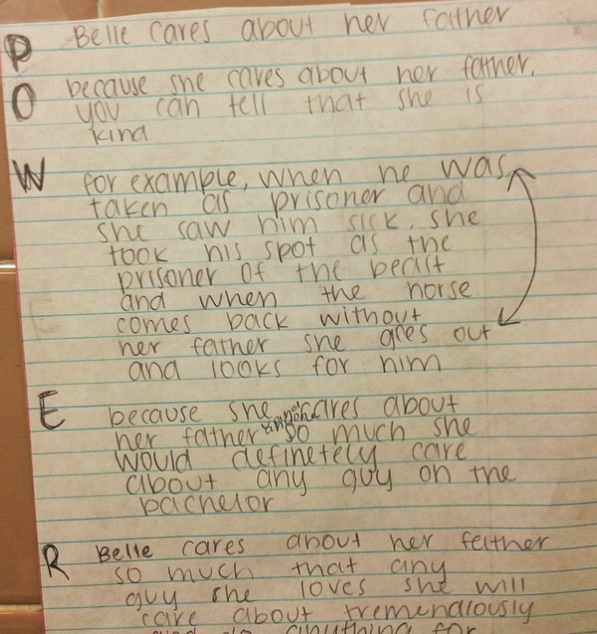
If every Disney princess were a contestant on a season of The Bachelor, who would win the heart of the bachelor?

Slide 16
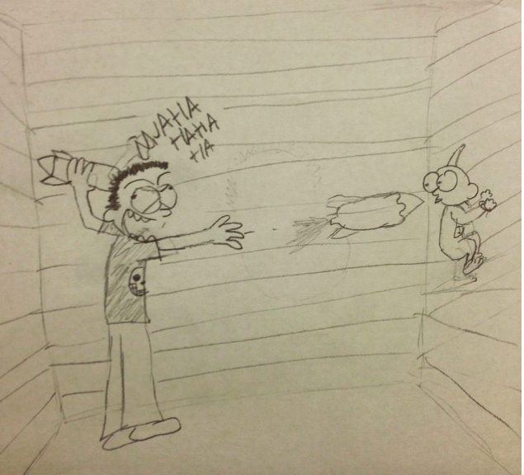
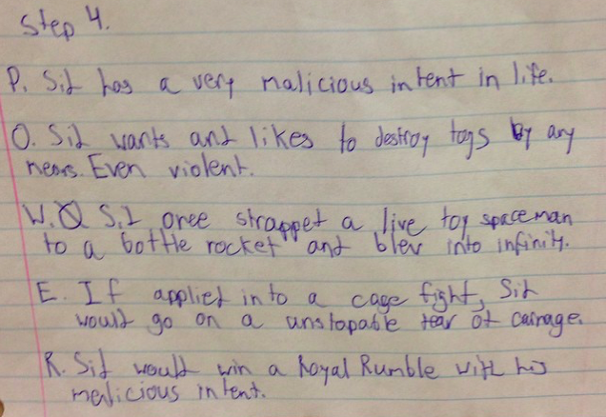
Draw the “W”

Slide 17
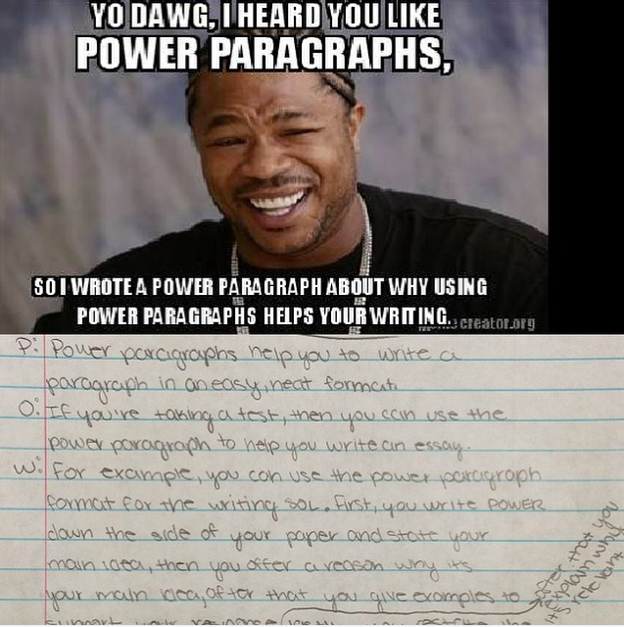

Slide 18
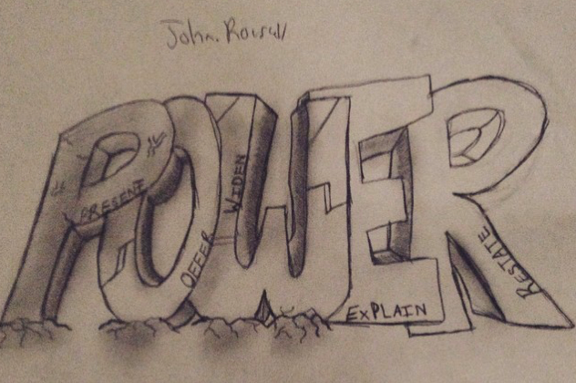
Questions????????

