Slide 1
Look at this cover picture and make a prediction
about what you think this story is about, write your prediction in the
First box on your paper.

Slide 2
Disgrace
Definition:
Causing shame, reproach, or dishonor

Slide 3
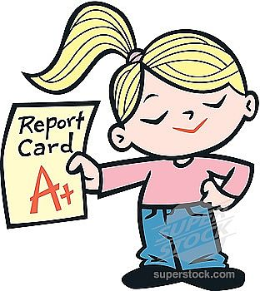
Sagely
Definition:
Acting wisely, intelligently

Slide 4
Rarities
Definition:
something rare, unique, uncommon

Slide 5
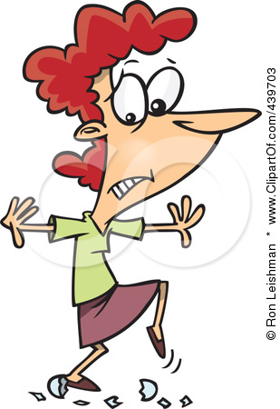
Gingerly
Definition:
cautious, careful, or wary.

Slide 6
Incidentally
Definition:
Additional comment or idea connected to original thought.
Original thought
Additional comment

Slide 7
Incredulous
Definition:
indicating or showing disbelief

Slide 8
Nonchalantly
Definition:
coolly unconcerned, indifferent, or unexcited; casual:

Slide 9
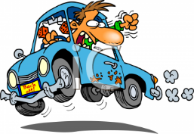
Reckless
Definition:
Without caution; careless

Slide 10
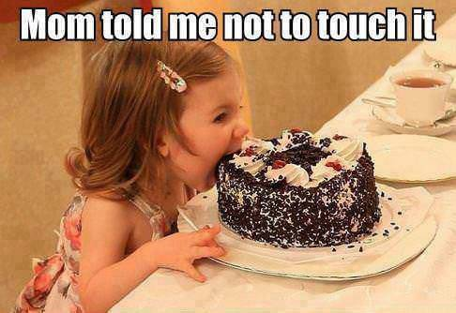
Irresistibly
Definition: not resistible; incapable of being resisted; too tempting

Slide 11
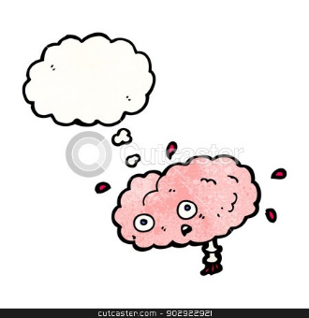
Unfathomable
Definition:
Unable to be fathomed, completely understood; incomprehensible

Slide 12
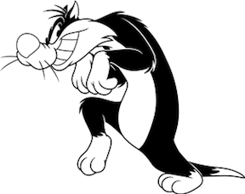
Roguishly
Definition:
playfully mischievous

Slide 13
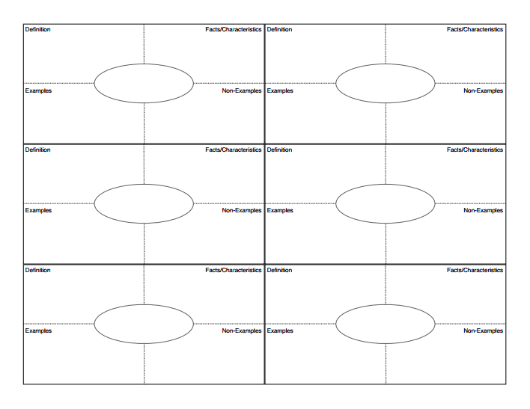
The Outsiders Intro/Vocabulary
Look at the picture displayed on the board and make a prediction
about what you think this story is about, write your prediction in the
space below.
Loo
rarities
disgrace
gingerly
sagely
incidentally

Slide 14
The Outsider Vocabulary
incredulous
irresistibly
nonchalantly
unfathomable
reckless
roguishly

