Slide 1
How a bill becomes a LAW

Slide 2
7 steps for a bill to become a LAW!

Slide 3
Step 1
Hi, I’m Bill!
Nice to meet you Bill!
Bill is introduced

Slide 4
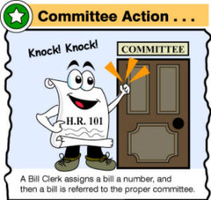
Step 2
It’s me Bill! I’m here for the committee to study me!
Bill is sent to a committee/subcommittee
Bill is introduced

Slide 5
Step 3
Bill is debated on
Bill is sent to a committee/subcommittee
Bill is introduced

Slide 6
Step 4
Vote for me!!
Bill is voted on
Bill is debated on
Bill is sent to a committee/subcommittee
Bill is introduced

Slide 7
Step 5
Time to move to the other house to do it all over again!
Bill passes in one house it’s sent to the other house for the same process
Bill is voted on
Bill is debated on
Bill is sent to a committee/subcommittee
Bill is introduced

Slide 8
Step 6
Conference Committee
Pass
Pass
Bill passes both houses it goes to conference committee for final tweaking
Bill passes in one house it’s sent to the other house for the same process
Bill is voted on
Bill is debated on
Bill is sent to a committee/subcommittee
Bill is introduced

Slide 9
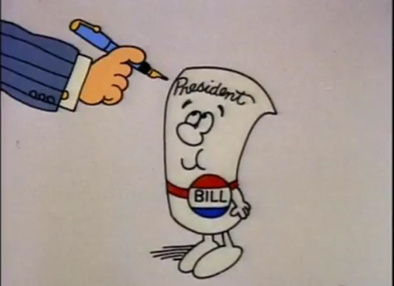
Step 7
Yay! I passed! I’m a law!
Bill sent to President for
Signing (approval) or Veto
Bill passes both houses it goes to conference committee for final tweaking
Bill passes in one house it’s sent to the other house for the same process
Bill is voted on
Wahhhhh ☹
I didn’t pass- VETO
Bill is debated on
Bill is sent to a committee/subcommittee
Bill is introduced

